Slide 1
Practical Environmental Impact assessment
James Watt
28/08/206 – 03/09/2026

Slide 2
The Course structure
Field Course component in Glenmore forest
3 hr Seminar – Week 1 – 5 (Tuesday 10am)
Assessment
  50 % Coursework =- writing an Environmental Impact Assessment
  50 % Exam (2 hr exam)

Slide 3
The course – an overview
Enhance skills and understanding in using advanced ecological and environmental field methodologies to collect data in support of evidence-based Environmental Impact Assessments (EIA).
Critically evaluate specialised field methodologies, including their limitations and suitability for professional impact assessment contexts.
Analyse and interpret ecological and environmental field data using appropriate quantitative approaches to establish environmental baselines.
Synthesise field evidence within the framework of an EIA to assess impact significance and propose mitigation options.
Generate an EIA that addresses impacts, while ensuring a balanced consideration of ecological, social, and economic priorities.

Slide 4
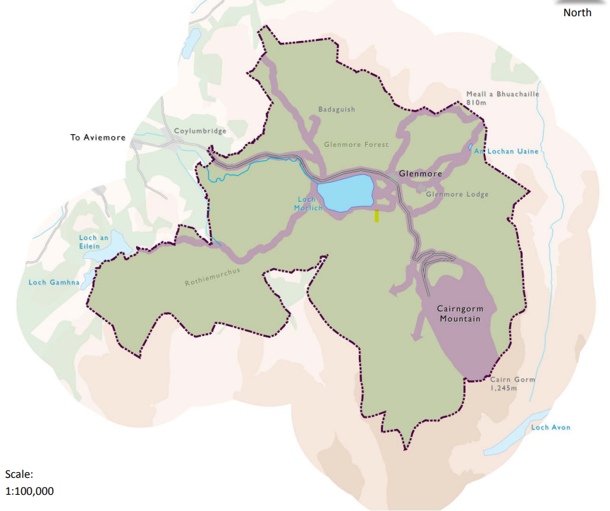
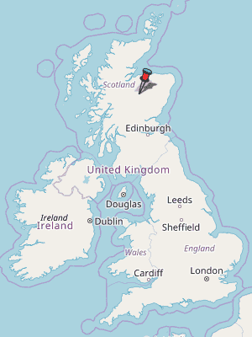

Slide 5
Glenmore has a large number of land use conflicts
Forestry- Primarily Scots Pine (Pinus sylvestris) forest, but also contains plantations of Sitka Spruce (Picea sitchensis), Lodge Pole Pine (Pinus Contorta and Norway Spruce (Picea Abies)
Freshwaters - The forest contains wetlands, rivers and lochs that have numerous protective categorisations e.g. RAMSAR,SSSI, NNR)
Biodiversity – Glenmore is part of a larger Cairngorms biodiversity action plan to promote charismatic taxa e.g. Capercaillie, Red Squirrel, Beavers, restoring native forests etc.
Soils and Peatlands – Major projects under way restoring peatlands in the National park – recently 60 hectares of peat has been resorted proximal to the cairngorms rail way
Tourism and access – over 500,000 visitors access the forest every year, and this number continues to increase. Large push to increase facilities and infrastructure for tourism.

Slide 6
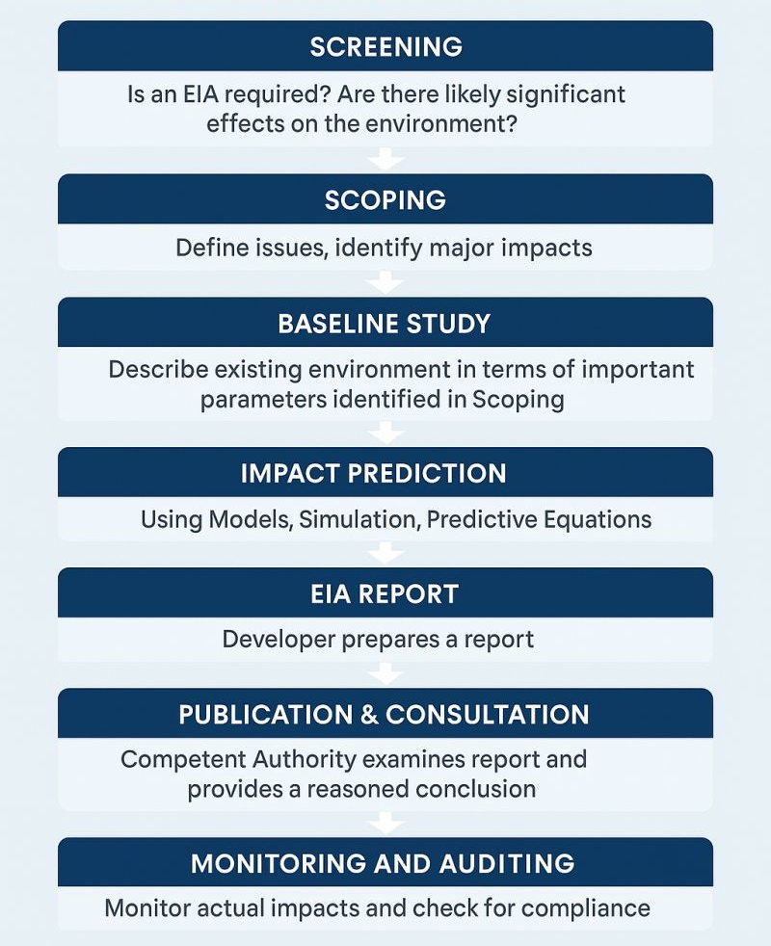
Environmental Impact Assessment (EIA)
EIA is a process that is meant to identify potential environmental impacts of land use change
Understanding how projects may affect the environment is contingent of good quality baseline data

Slide 7
This field course is all about baselining
Baseline data can be sought in two different ways
  Desk based: Uses existing information about sites from planning records, GIS outputs, maps, environmental databases (GBIF, NBN atlas)
  Baseline Study: Collects new site specific information using scientifically backed methodologies and survey techniques. Identifies current conditions not captured in existing datasets
  Your Task this field course is collect a baseline dataset for the soils, freshwaters and biodiversity of the Glenmore Forest

Slide 8
The Baseline Study
You have been split into 3 groups of 16 members (Check LEARN)
Each group will tackle a different theme (Biodiversity, Freshwater, Biodiversity) each day
Each group will learn the same techniques but the sampling sites will be different, this way we can collect baseline information across a wide area of Glenmore forest.
Everyone will have the opportunity to work with the whole dataset during semester
The Baseline dataset will be used for the summative coursework – so its in everyone's best interest to stick in!
You all have an a4 map of Glenmore, make sure you mark down each day where you sampled and other interesting observations

Slide 9
Saturday
Group 1 – Soils
Group 2 – Biodiversity
Group 3 – Freshwaters
Sunday
Group 1 - Biodiversity
Group 2 - Freshwaters
Group 3 - Soils
Monday
Group 1 - Freshwaters
Group 2 - Soils
Group 3 – Biodiversity
Tuesday
All groups – phase 1 habitat survey / impact prediction exercise
Group 1 | Group 2 | Group 3
Ariel Millar | Nina Kirk | Istara Datta
Xuanyi Zhao | Cameron Dalgleish | Yicheng Feng
Zara Bathurst | Tihani Binti Shahrudin | Jiaxuan Gong
Elizabeth Wardhaugh | Tarana Edwards | Isabel Ritchie
Isabell Ye | Scarlet Fletcher | Joesephine Rogerson
Adam Black | Zhaohang wang | Sophia Farouque
Xinyi Zhang | Isabel Sunley | Imogen Tyler
Sally Borrowman | Charlotte Hillier | Yanting Shen
Katy Gailbrath | Patrick hanley | May Nishimura
Weiran Cao | Olivia Elliott-smith | Vadim Laime
Ethan Lomax | Sam Barker | Madeline Ryall-west
Unnabh Ghosh | Elspeth Panter | Holden Duncan
Mako Shibata | Lyle Hunter | Luke Hampshire
Amy Menzies | Abbigail Johnstone | Caitlin Graham
Ciara McManus | Ziyang Liu | Rowan Mcallister
Connor Cormick | Asia Kane | Hannah Caves

Slide 10
Field Notebooks
You are expected to keep a field note book
THIS IS NOT SUMMATIVELY ASSESSED (phew…….)
However, it will form part of the material that can help you prepare for the exam at the end of semester – all activities are examinable
Sunday Night after dinner the teaching teach will give formative feedback on your note taking

Slide 11
What should you be writing about
Date, surveyor(s), project/site name, and fieldwork purpose
Weather conditions, including temperature, rainfall, wind, cloud cover, and recent weather events, where relevant to survey results.
Site location, including grid references/GPS coordinates, site boundaries, access routes, and photographs or sketches of survey areas.
Survey timing, including start and finish times, and the timing of individual samples, transects, or observations.
Methods used, with enough detail for another competent person to repeat the work.
Raw data recorded at the time of collection, not only later summaries or calculations.
Sample identifiers, labels, storage conditions, preservation methods, chain-of-custody details, and intended laboratory analysis where samples are taken.
Equipment calibration and checks, including calibration results, equipment faults, cleaning/decontamination procedures, and any deviations from the planned method.
Annotated maps, sketches, and field diagrams to support written observations. Record photo numbers, direction, location, and subject.
Unexpected conditions or deviations, for example restricted access, flooded ground, poor visibility, equipment failure, disturbed habitats, or changes to sampling locations.
Initial observations and interpretation, clearly separated from raw data. Note potential environmental receptors, pathways, sources of impact, and uncertainties.
Data limitations and confidence, including whether conditions were appropriate for the survey and whether results are representative of the baseline.

